Slide 1

DEPARTMENTAL STORE MANAGEMENT SYSTEM
PRESENTED BY:
Ashutosh Kumar- 46274552 Ashutosh Mahapatro- 46275217 Azmeera Yamini - 46275252 Chintamneedi Aswini - 46275218 Ekta Pandey - 46275309

Slide 2
MEMBERS CONTRIBUTON
Ashutosh Kumar-logical test plan initial contribution , Coding part execution , Design part review, schedule updation.
Ashutosh Mahapatro-Design flowcharts , Code execution , RTM ,PPT preparation and UT-IT test plan
Azmeera Yamini-Coding exceution , MOM , SRS , HLD &LLD and Code checklist review .
Chintamneedi Aswini- SRS part done, coding execution , make file , schedule and Hld &lld.
Ekta Pandey- use cases diagram, RTM , coding execution , UT_IT testplan and Plan update.

Slide 3
INTRODUCTION
Departmental store Mangement System provides business with the ability to computerize,systemize and correlate reatail information.
DSMS enables cashiers to process transcations and serve customers efficiently and allows managers to maintain tight control.
Main objective of the project is to store and manage the details of products and customers.

Slide 4


AIM OF THE PROJECT

Slide 5
Overview of our Project
Login
Insert product
Display product
Search product
Edit product
Delete product
Sales Report

Slide 6
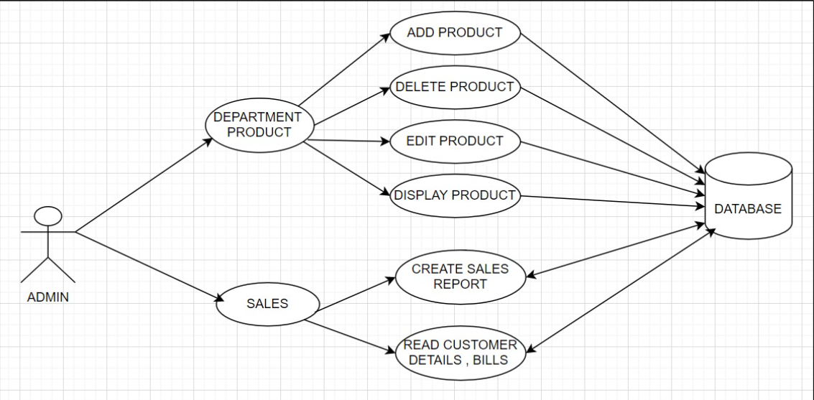
FLOW CHART

Slide 7
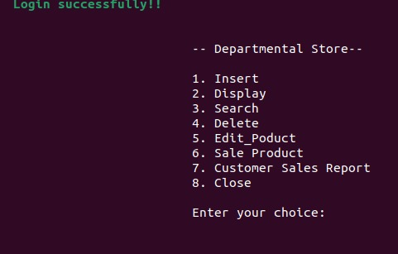
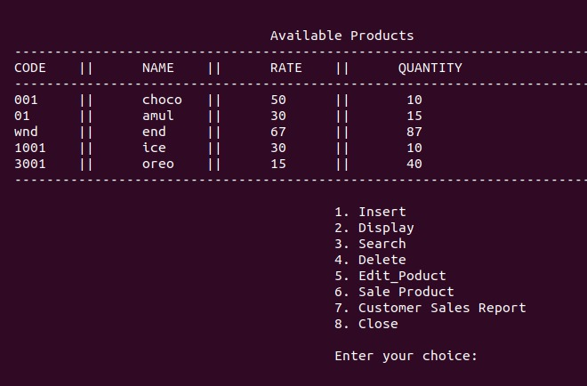
OUTPUT CODES login Insert & Delete

Slide 8
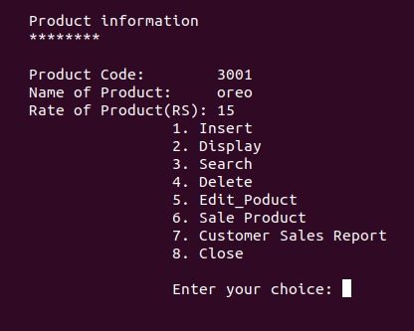
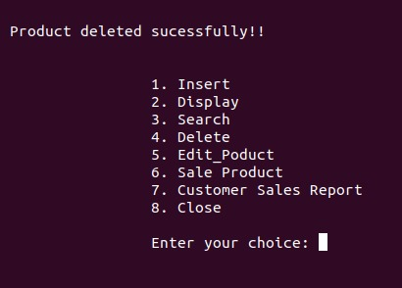
Search product Delete product

Slide 9
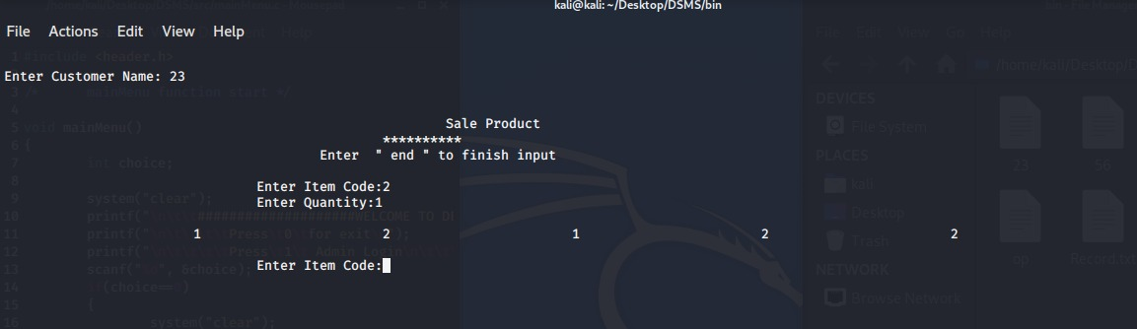
Sale product

Slide 10


